Slide 1


Day 3
Math24 (Differential Equations)
Ch 1.2 Solutions of Some Differential Equations (Page 10-19)
Elementary Differential Equations and Boundary Value Problems, 10th edition, by William E. Boyce and Richard C. DiPrima, ©2013 by John Wiley & Sons, Inc.

Slide 2


Recall the free fall and owl/mice differential equations:
These equations have the general form y' = ay - b
We can use methods of calculus to solve differential equations of this form.

Slide 3
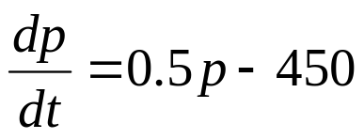
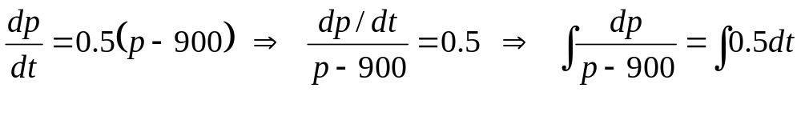
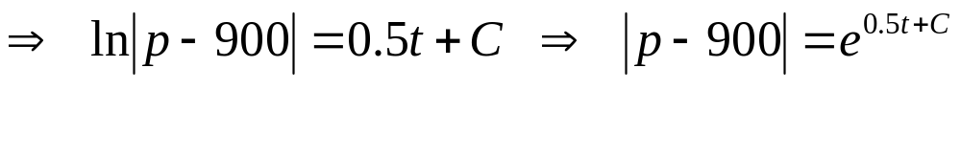
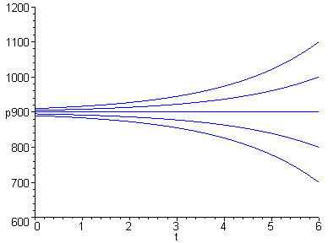

Example 1: Mice and Owls (1 of 3)
To solve the differential equation
we use methods of calculus, as follows.
Thus the solution is
where c is a constant.

Slide 4
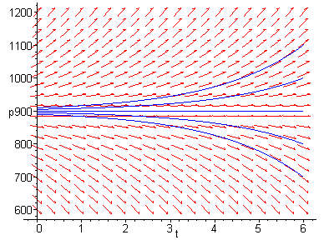
Example 1: Integral Curves (2 of 3)
Thus we have infinitely many solutions to our equation,
since k is an arbitrary constant.
Graphs of solutions (integral curves) for several values of c, and direction field for differential equation, are given below.
Choosing c = 0, we obtain the equilibrium solution, while for c ≠ 0, the solutions diverge from equilibrium solution.

Slide 5
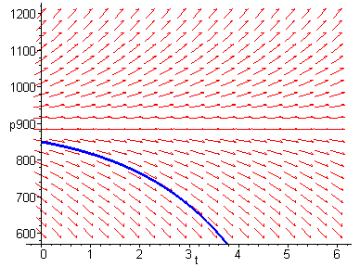





Example 1: Initial Conditions (3 of 3)
A differential equation often has infinitely many solutions. If a point on the solution curve is known, such as an initial condition, then this determines a unique solution.
In the mice/owl differential equation, suppose we know that the mice population starts out at 850. Then p(0) = 850, and

Slide 6

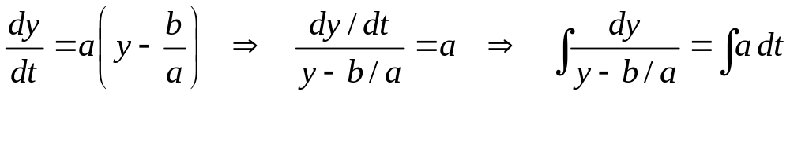
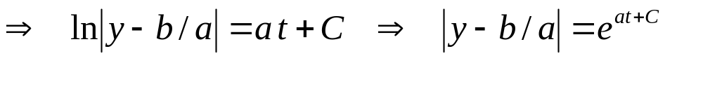
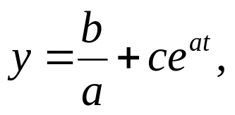
Solution to General Equation
To solve the general equation
we use methods of calculus, as follows.
Thus the general solution is
where c is a constant.

Slide 7

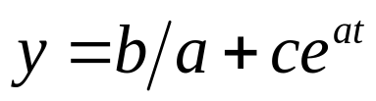
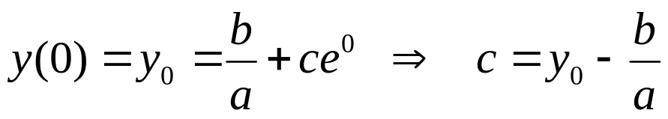
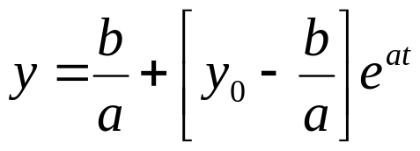
Initial Value Problem
Next, we solve the initial value problem
From previous slide, the solution to differential equation is
Using the initial condition to solve for c, we obtain
and hence the solution to the initial value problem is

Slide 8
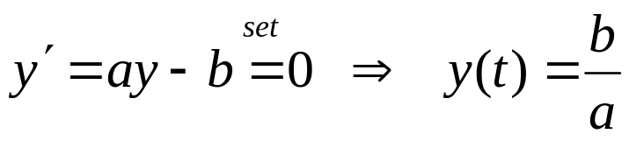
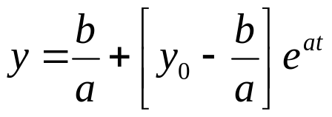
Equilibrium Solution
To find the equilibrium solution, set y' = 0 & solve for y:
From the previous slide, our solution to the initial value problem is:
Note the following solution behavior:
  If y₀ = b/a, then y is constant, with y(t) = b/a
  If y₀ > b/a and a > 0 , then y increases exponentially without bound
  If y₀ > b/a and a < 0 , then y decays exponentially to b/a
  If y₀ < b/a and a > 0 , then y decreases exponentially without bound
  If y₀ < b/a and a < 0 , then y increases asymptotically to b/a

Slide 9


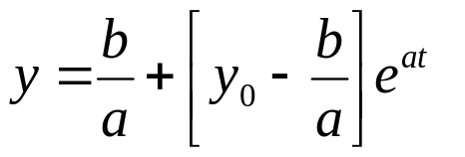
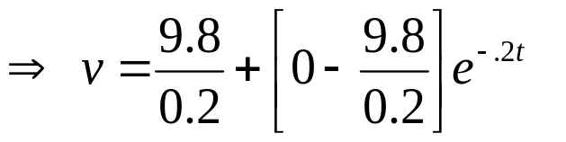

Example 2: Free Fall Equation (1 of 3)
Recall equation modeling free fall descent of 10 kg object, assuming an air resistance coefficient γ = 2 kg/sec:
Suppose object is dropped from 300 m. above ground.
  (a) Find velocity at any time t.
  (b) How long until it hits ground and how fast will it be moving then?
For part (a), we need to solve the initial value problem
Using result from previous slide, we have

Slide 10
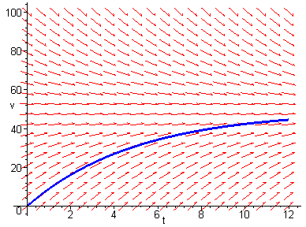


Example 2: Graphs for Part (a) (2 of 3)
The graph of the solution found in part (a), along with the direction field for the differential equation, is given below.

Slide 11



Example 2
Part (b): Time and Speed of Impact (3 of 3)
Next, given that the object is dropped from 300 m. above ground, how long will it take to hit ground, and how fast will it be moving at impact?
Solution: Let s(t) = distance object has fallen at time t.
It follows from our solution v(t) that
Let T be the time of impact. Then
Using a solver, T ≅ 10.51 sec, hence

